Slide 1
Variable trends in pteropod abundance between the shelf and slope from two decades of observations off Newport Oregon, USA
Jennifer L. Fisher, William T. Peterson, Brandon Chasco

Slide 2
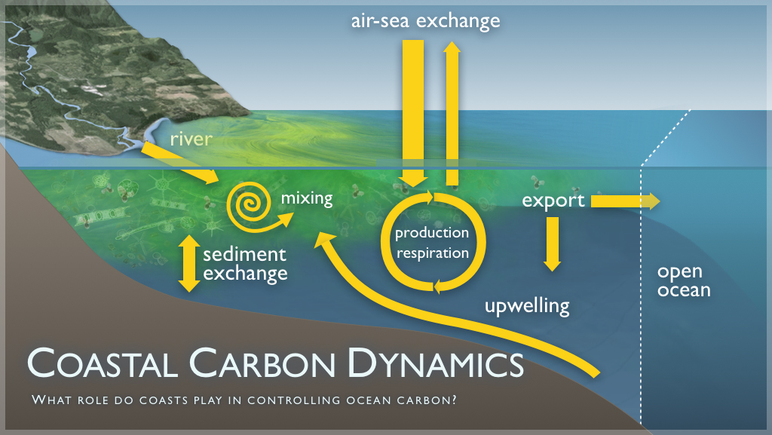

Slide 3
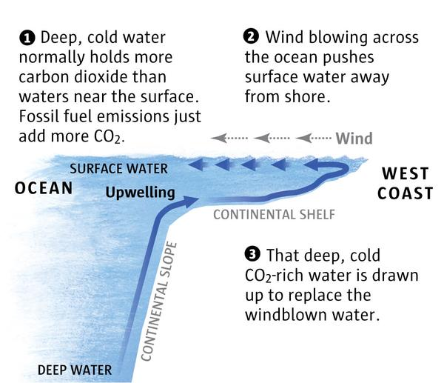
Upwelling delivers CO₂-rich water to the continental shelf
North America
From the Seattle Times- Mark Nowlin
Notes:
A different upwelling slide (by NOAA no less) in case you want to drive the point home about the paradigm that upwelling drives productivity and zooplankton production…I put the next one in there too…

Slide 4
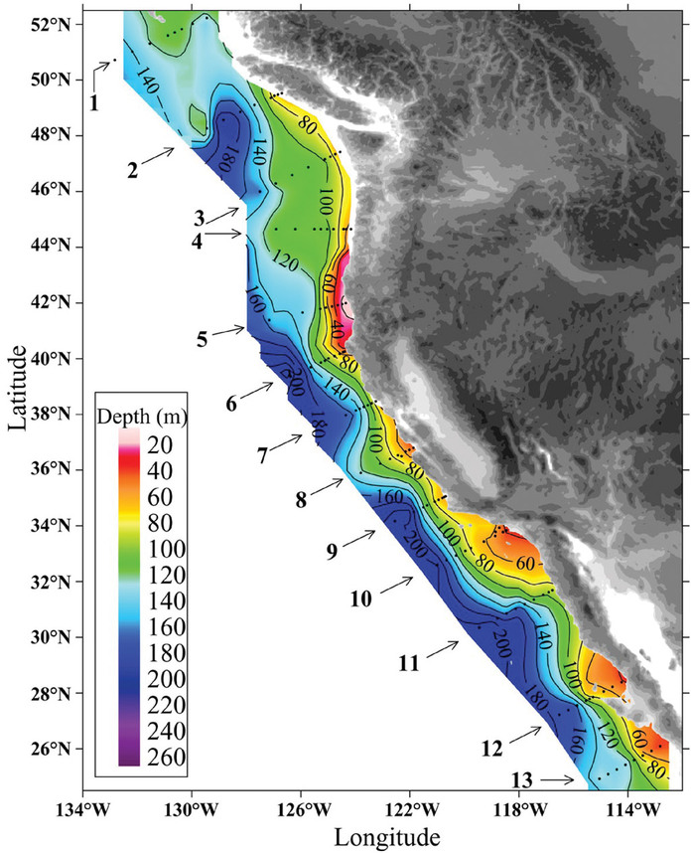
From Feely et al. 2008

Slide 5
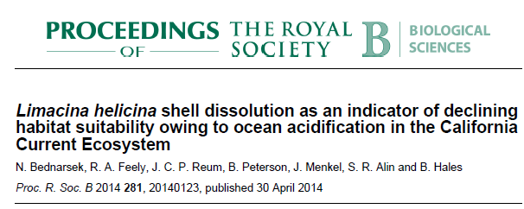
Saturation depth has shallowed and fraction of water column that is corrosive has increased since the pre-industrial era
From Bednarsek at al. 2014

Slide 6
The first field observation recording shell dissolution from corrosive (undersaturated) water
Study conducted in 11 Aug – 3 Sept, 2011
Pteropods collected from bongo samples
Sampled NH-10, NH-15, NH-35
NH-10, NH-15
Shell size 0.5-2 mm
75% had severe shell dissolution
NH-35
Shell size 1-2.5 mm
25% has severe shell dissolution

Slide 7
Objectives
Determine the intra and inter-annual patterns of aragonite saturation and limacina on the shelf and slope
Determine if the seasonal and long term trends in Limacina are correlated from aragonite saturation or other environmental parameters
Are there a suite of environmental parameters that best characterize the intra and interannual patterns in Limacina abundance
Outline- season then long term trends

Slide 8
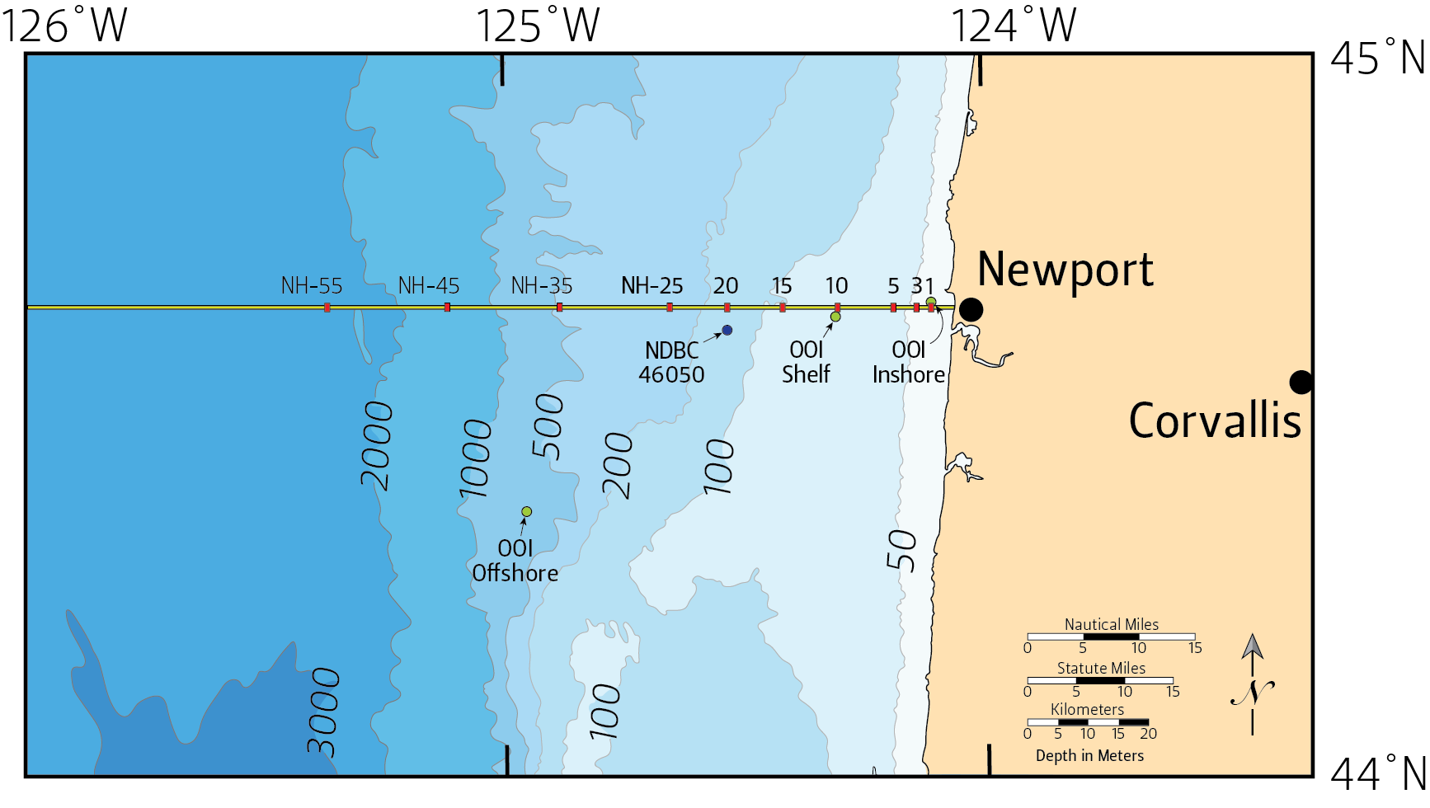
Need map to show shelf vs slope, point out Nina’s site? Talk about active upwelling on the shelf but not on the slope

Slide 9
Methods
Aragonite saturation derived from CTD casts- derived from oxygen and temperature (Juranek at al. 2009)
2 stations- slope (300 m) and shelf (60 m)
Vertical nets towed over the upper 100 m or 2m off the bottom
Limacina data from 1996 – present
Oxygen sensor obtained in 2006 so aragonite saturation from 2006 – present
Combination of time-series modelling and GLM for initial model
NEED to be able to explain the time-series- Eric Ward ref

Slide 10
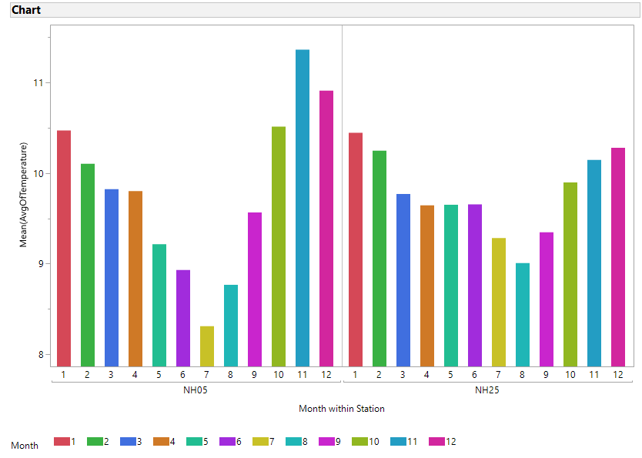
Seasonality of temperature on the shelf versus slope- active summer upwelling on the shelf but not the slope- order everything so that slope comes first- then shelf
Upper 100m T

Slide 11
Seasonality of corrosive water on the shelf versus slope- add mean line to these

Slide 12
Seasonality of corrosive water on the shelf versus slope- add sig diffs?

Slide 13
Seasonality of corrosive water on the shelf versus slope

Slide 14
Patterns of undersaturated water consistent between 2011 (Bednarsek et al. 2014) and present study
During peak period of undersaturation
% individuals encountering sever dissolution:
Shelf = 75%
Slope = 25%

Slide 15
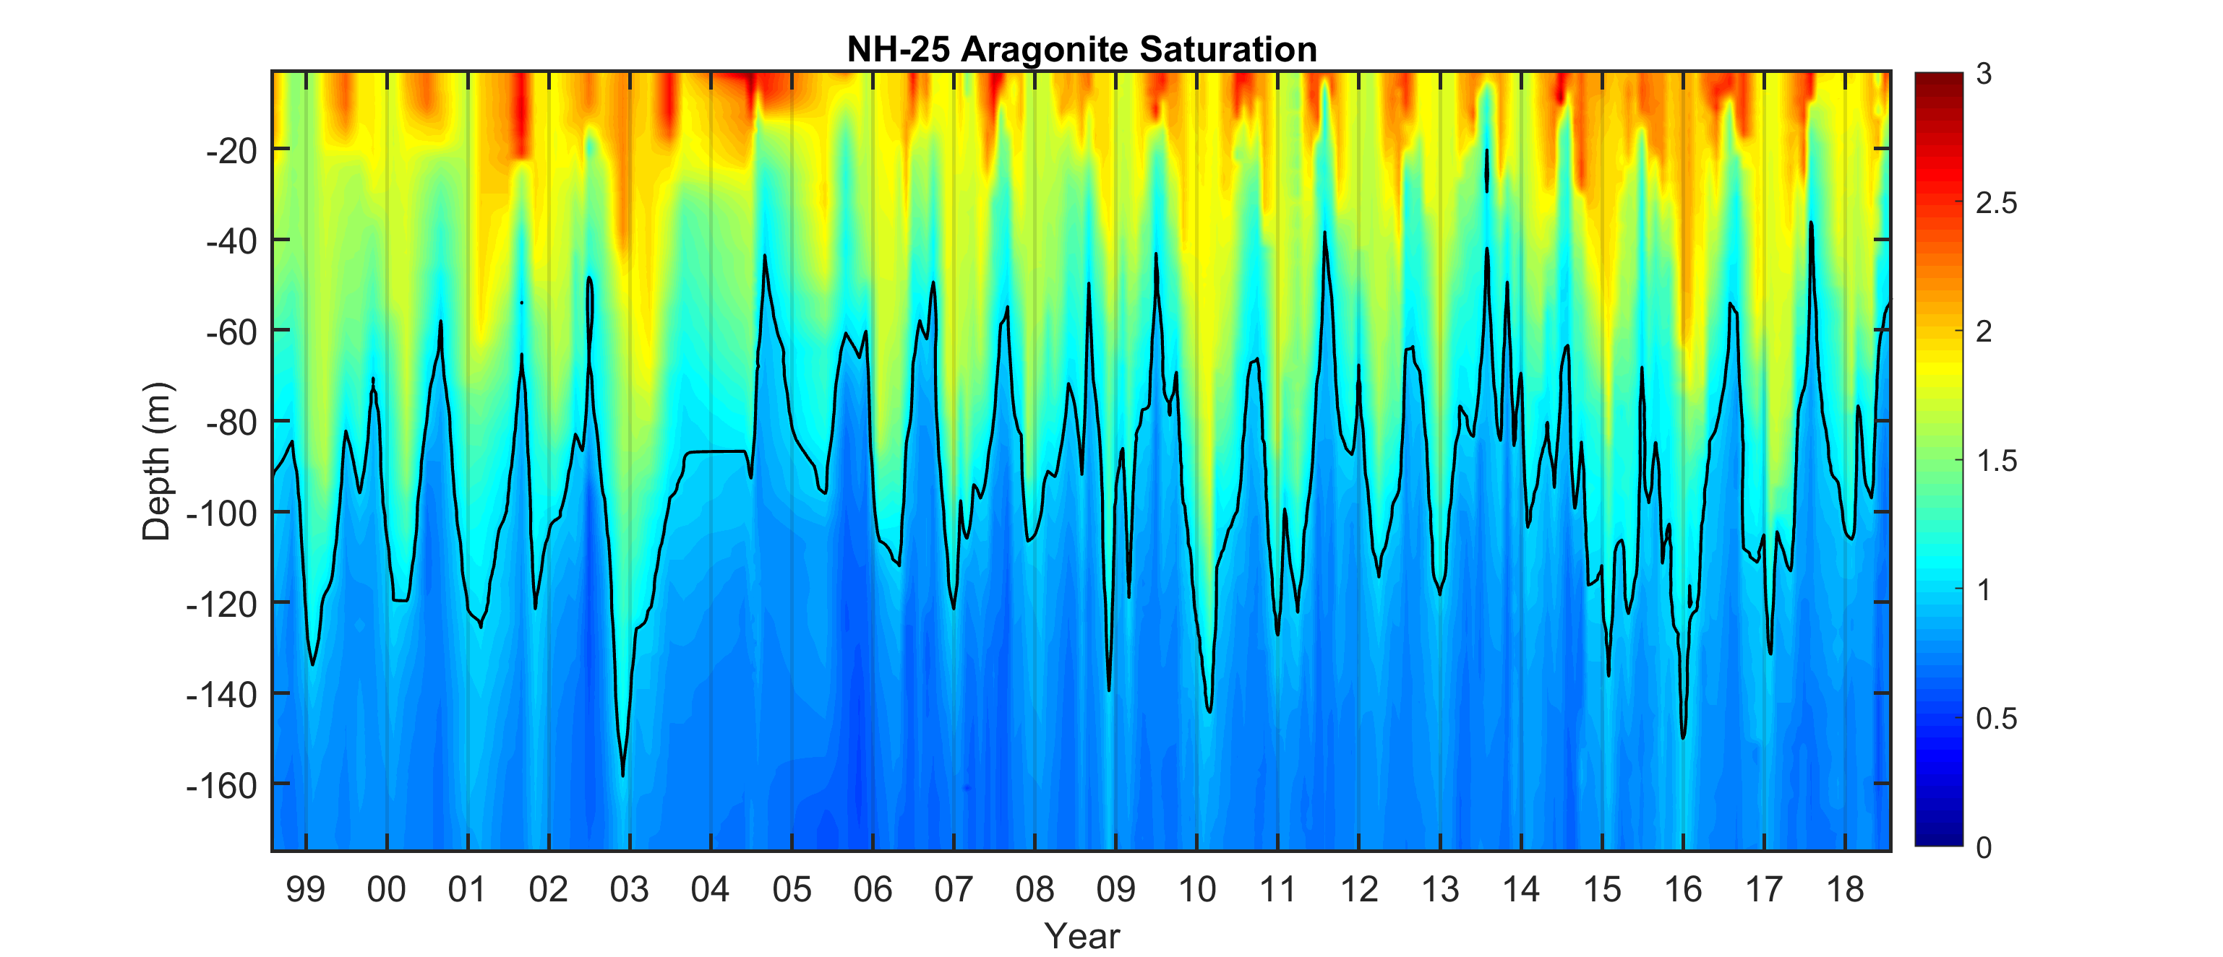
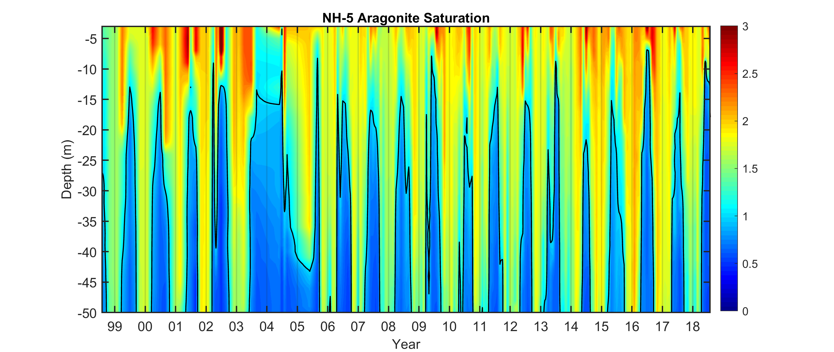

Slide 16
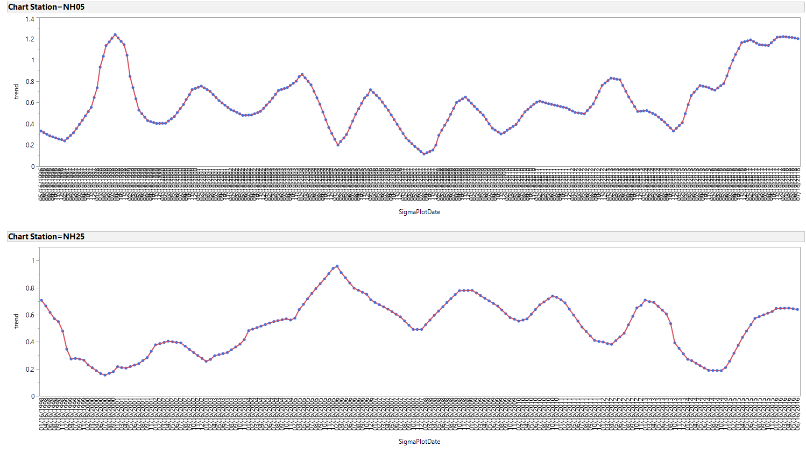
Long term trends

Slide 17
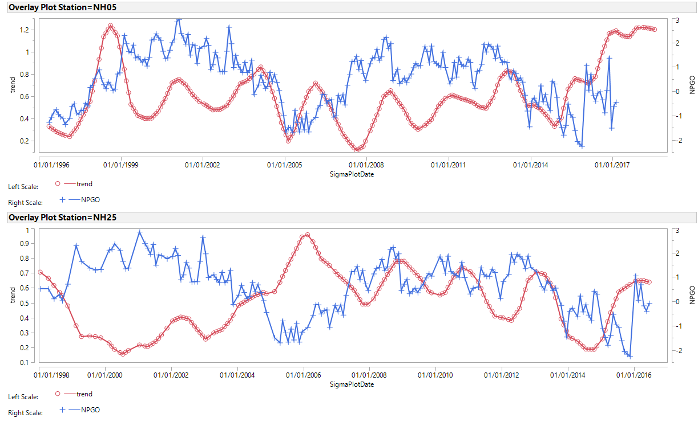
Correlation or cross- correlation with long term trend and env vars

Slide 18
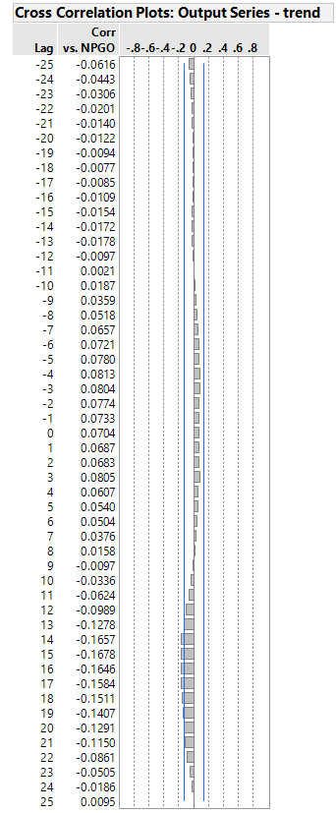
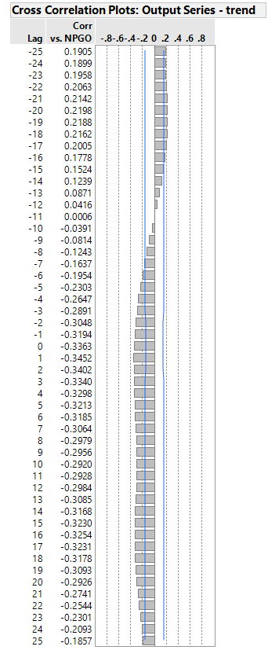
NH-5
NH-25

Slide 19
GLM prelim results- working towards zero-inflated model
 | Slope- NH-25 |  |  | Shelf- NH-5
Effect | coefficient | p-value |  | coefficient | p-value
Year |  | * |  |  | ***
Month |  | *** |  |  | ns
% water Ω<1 | -0.02 | * |  | -0.03 | ***
NPGO | -0.48 | * |  | -1.04 | *
Strong month effect of Limacina density on the slope but not significant on the shelf
Aragonite has a stronger effect on Limacina density on the slope compared to shelf- this is largely due to zero limacine during the corrosive period
No coherent trend in the year effect
NPGO significant on the shelf and slope- likely driving oxygen concentrations- JO Peterson et al. 2013

Slide 20
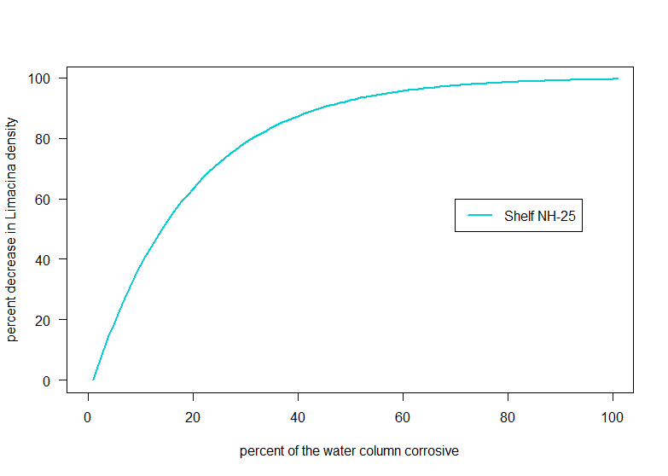
Effect plots
Effect of arag at NH-5 versus 25
Effect of NPGO??

Slide 21
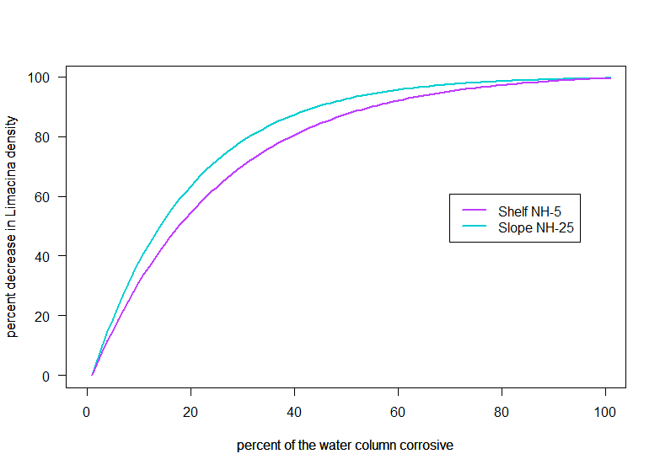
Effect plots
Effect of arag at NH-5 versus 25
Effect of NPGO??

Slide 22
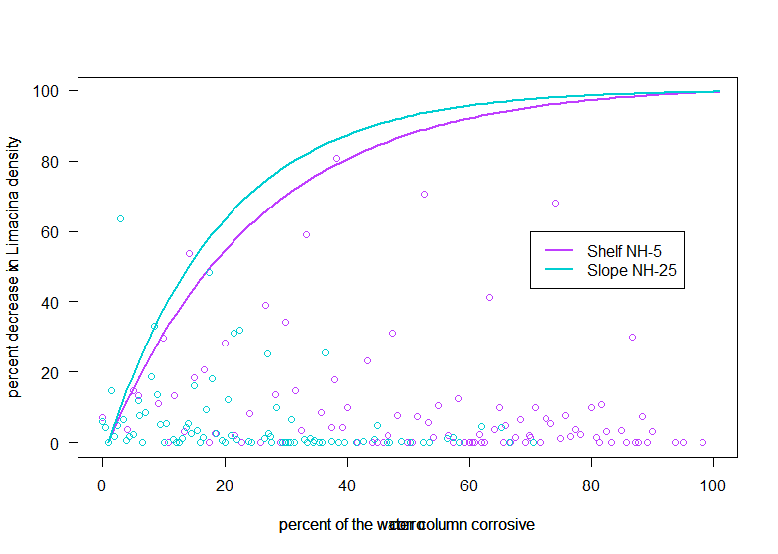
Effect plots
Effect of arag at NH-5 versus 25
Effect of NPGO??

Slide 23
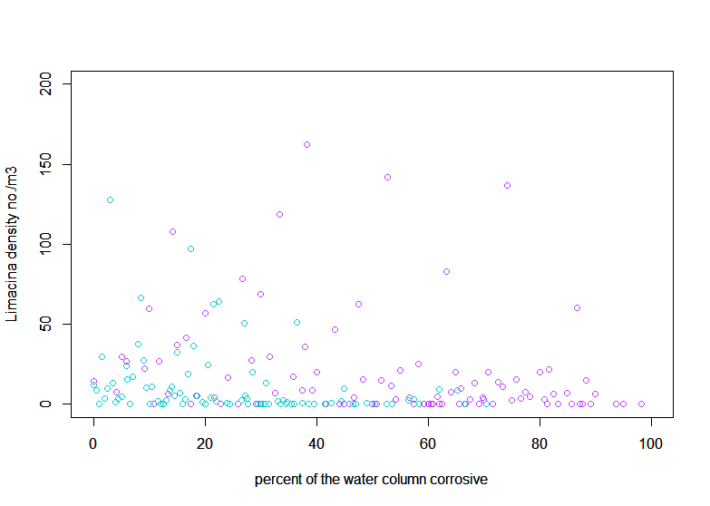
Effect plots
Effect of arag at NH-5 versus 25
Effect of NPGO??

Slide 24
Summary, conclusions, next steps

Slide 25
Acknowledgements

Slide 26
To do
Re-calculate arag sat using Simone’s algorithm
See if pteropod length, has a seasonal cycle, differs between stations, has changed over time, interaction of time and station
Compare full vert net counts to Bill’s sub samples
Compare sizes in this study to Ninas- are we missing large animals
Look at Cheryl’s BPA data to see if we see the same patterns

Slide 29
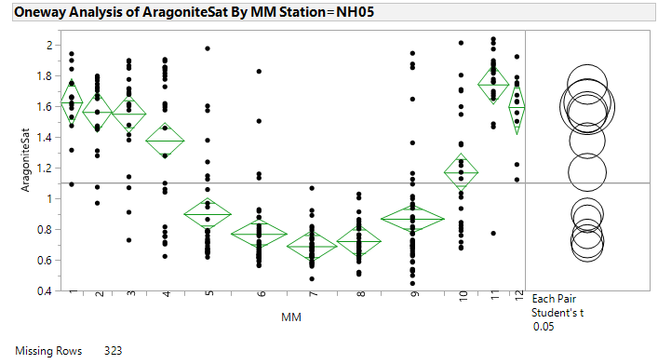
40m

Slide 30
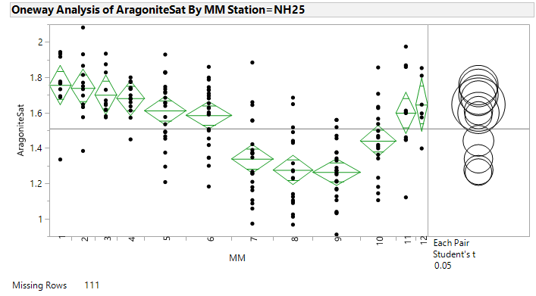
40m

Slide 33
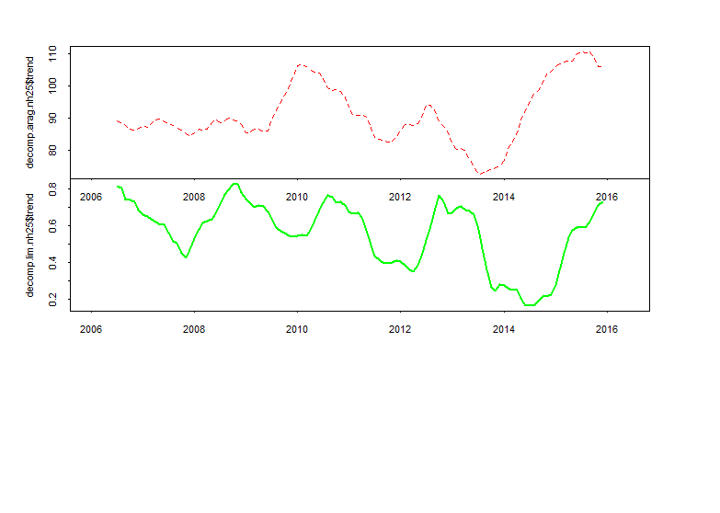
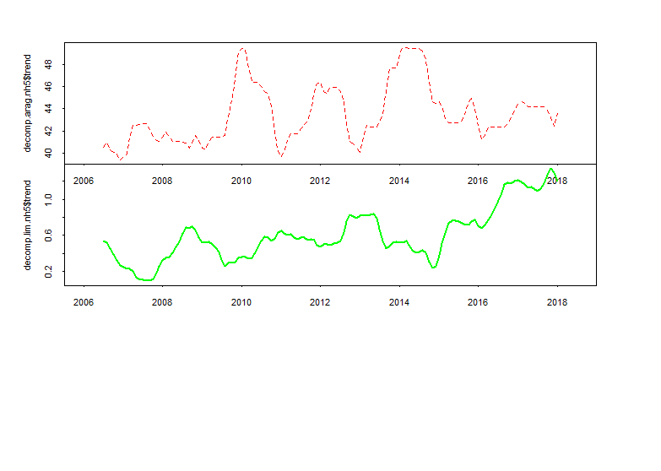

Slide 34
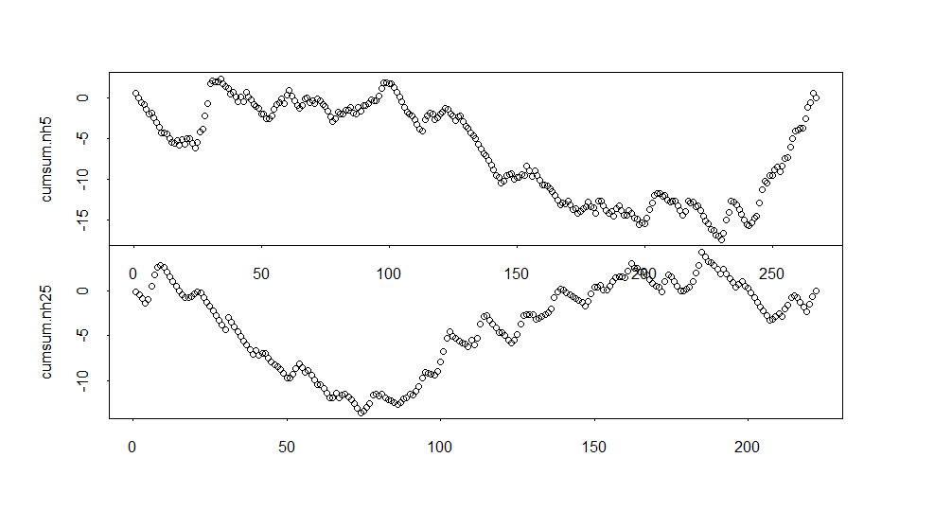

Slide 35
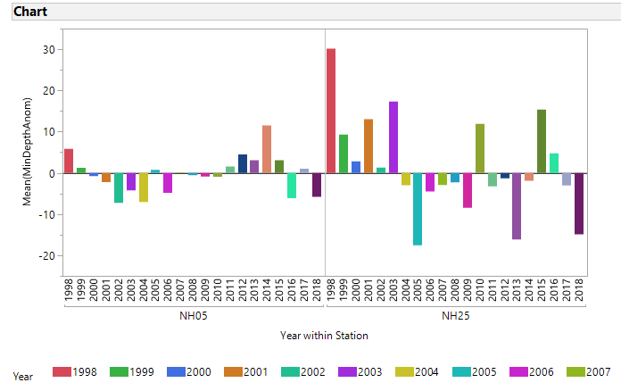

Slide 36
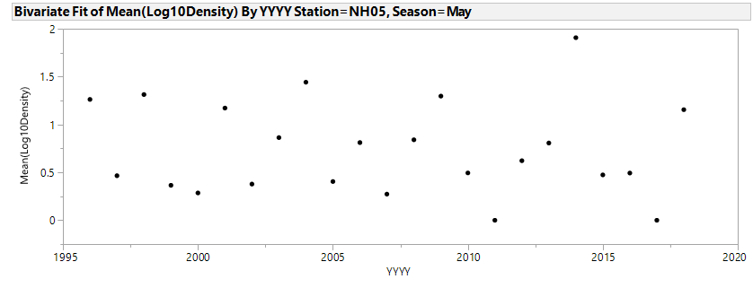
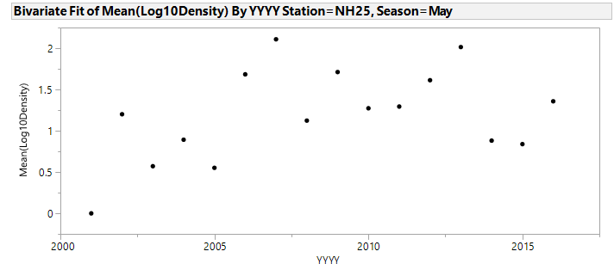

Slide 37
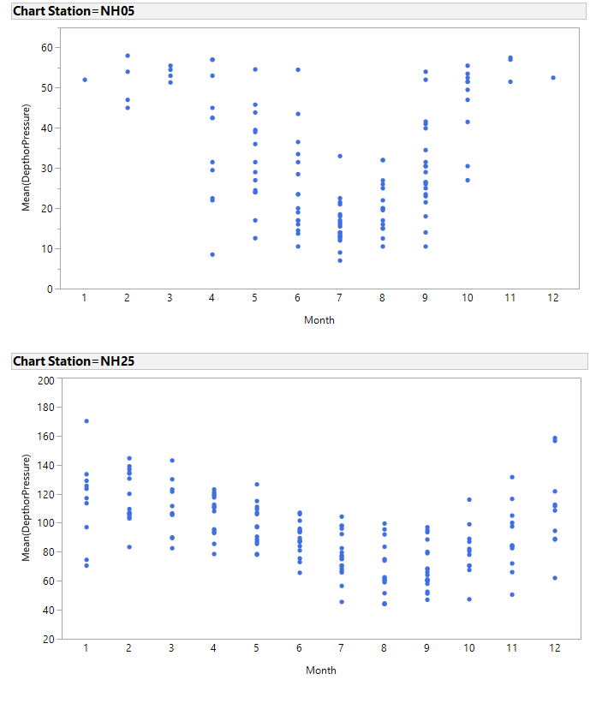
Seasonal depth pattern of Arag Sat equal to 1

Slide 38
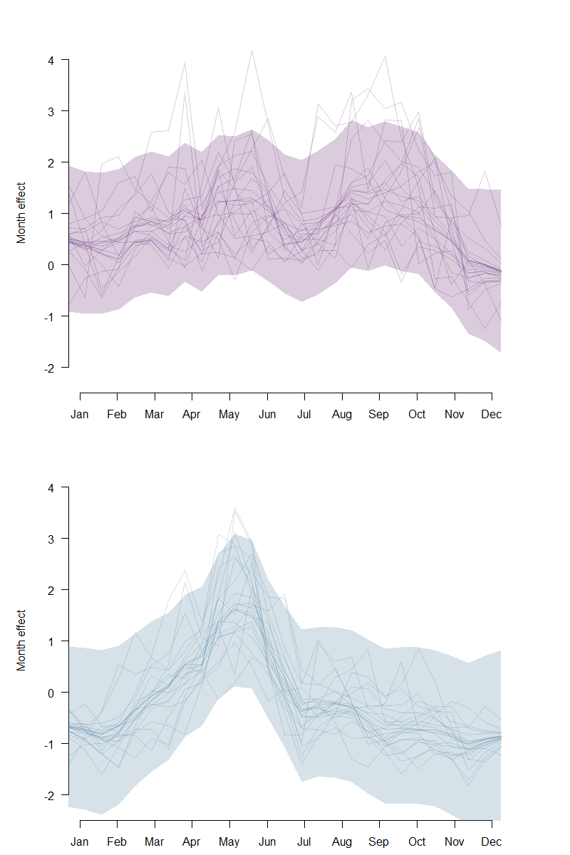

Slide 39
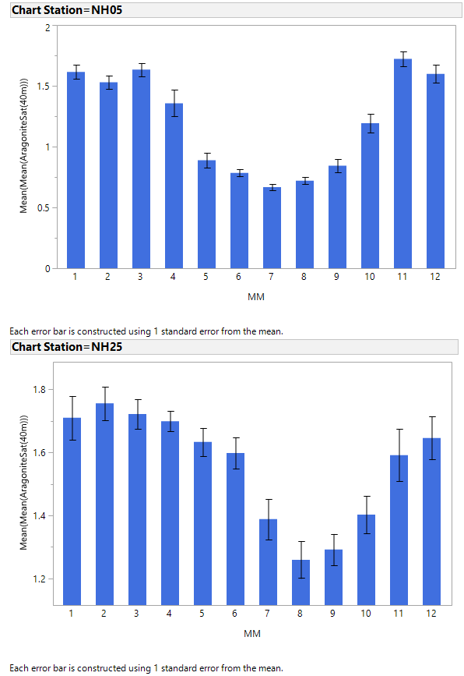

Slide 40
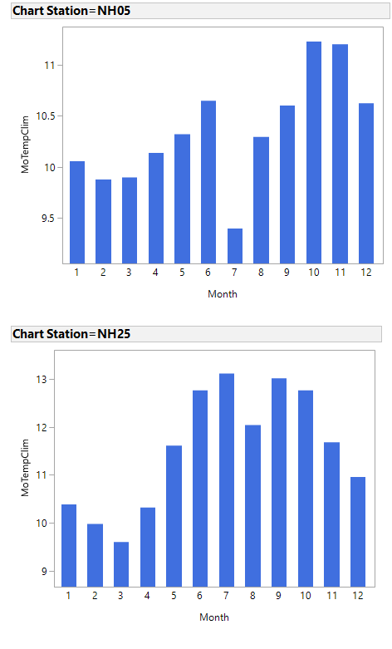
Upper 20m T

Slide 41
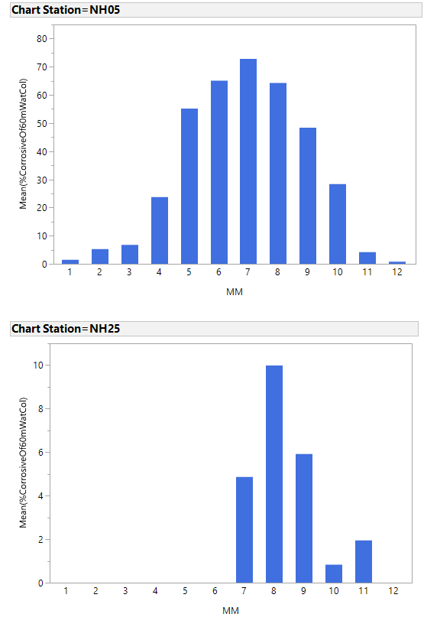

Slide 42
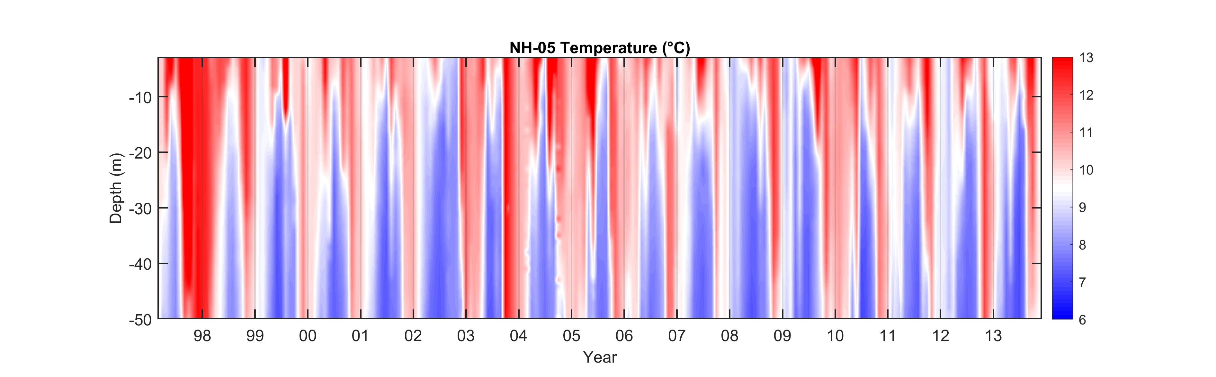

Slide 43
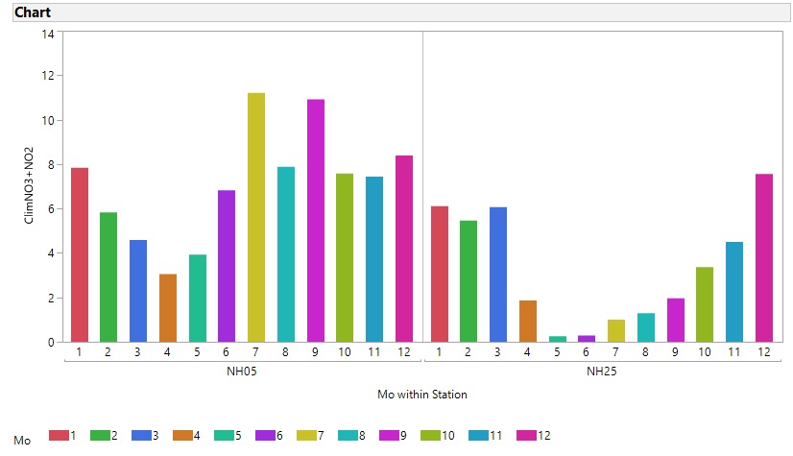
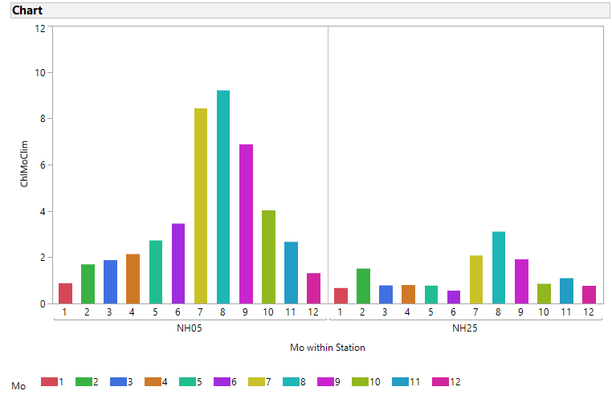
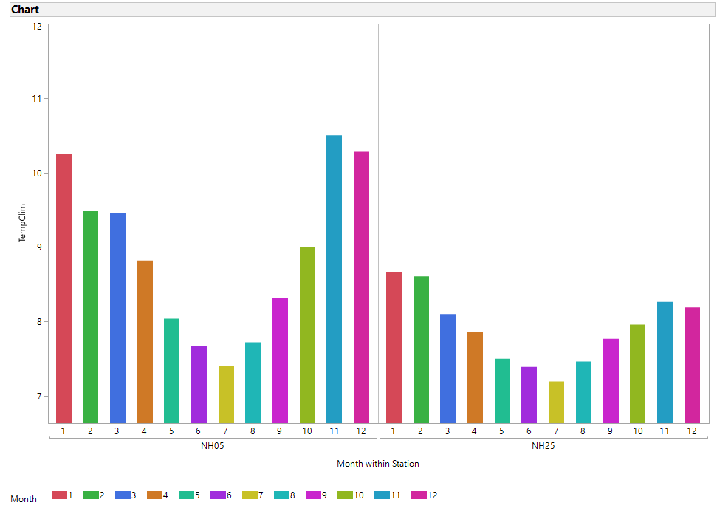
50m 150 m T
Upper 100m T

Slide 44
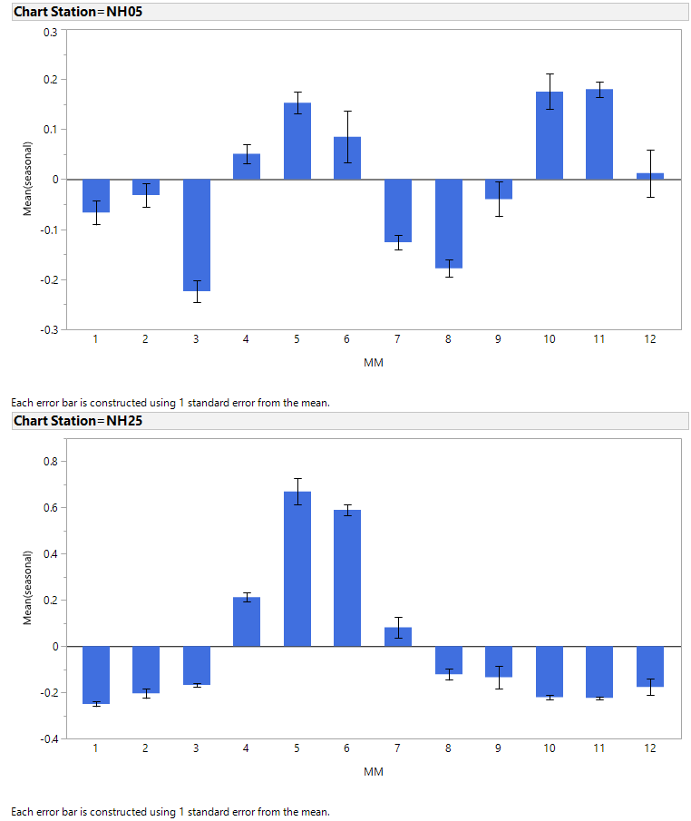

Slide 45
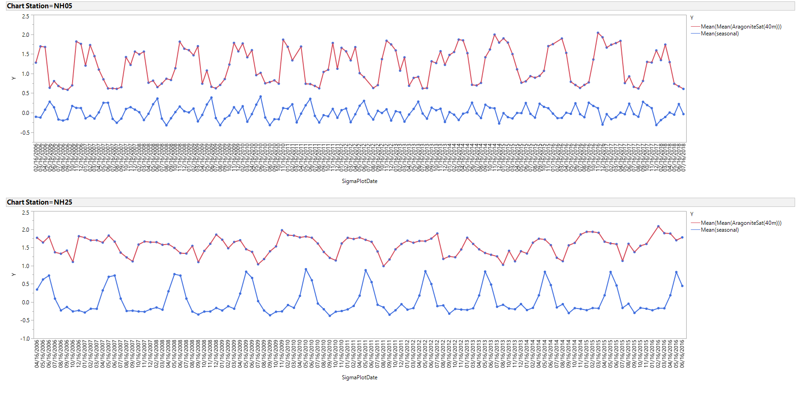

Slide 47
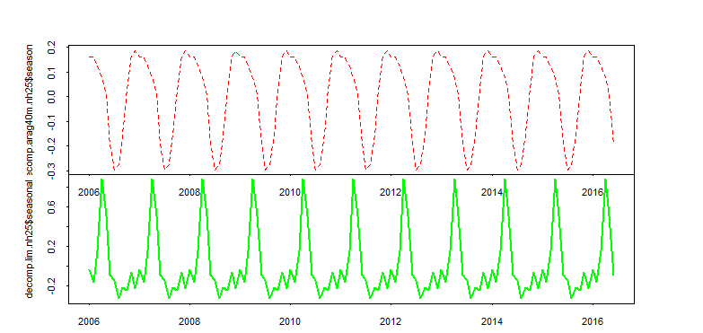
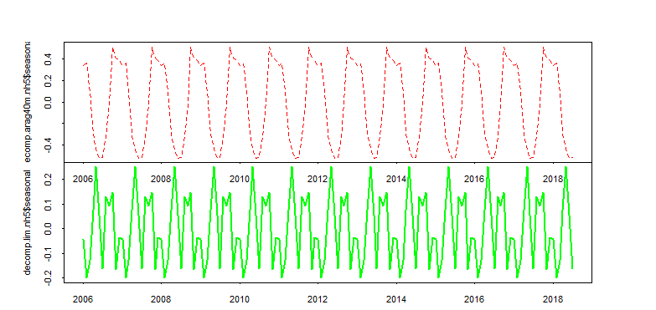

Slide 48
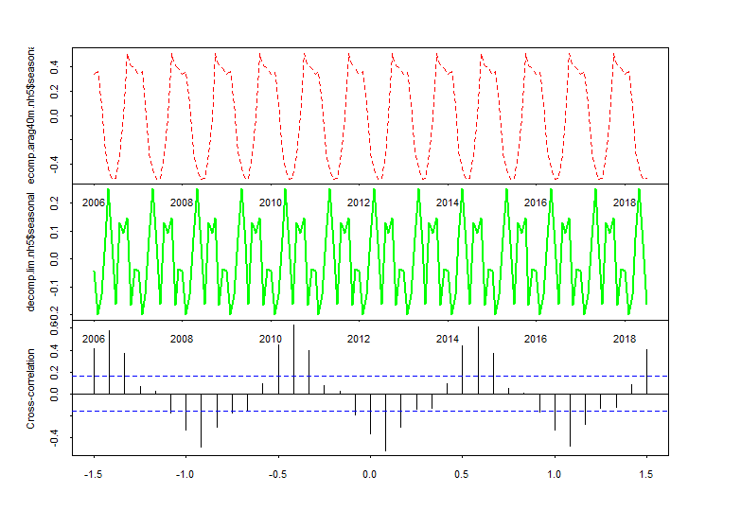

Slide 49
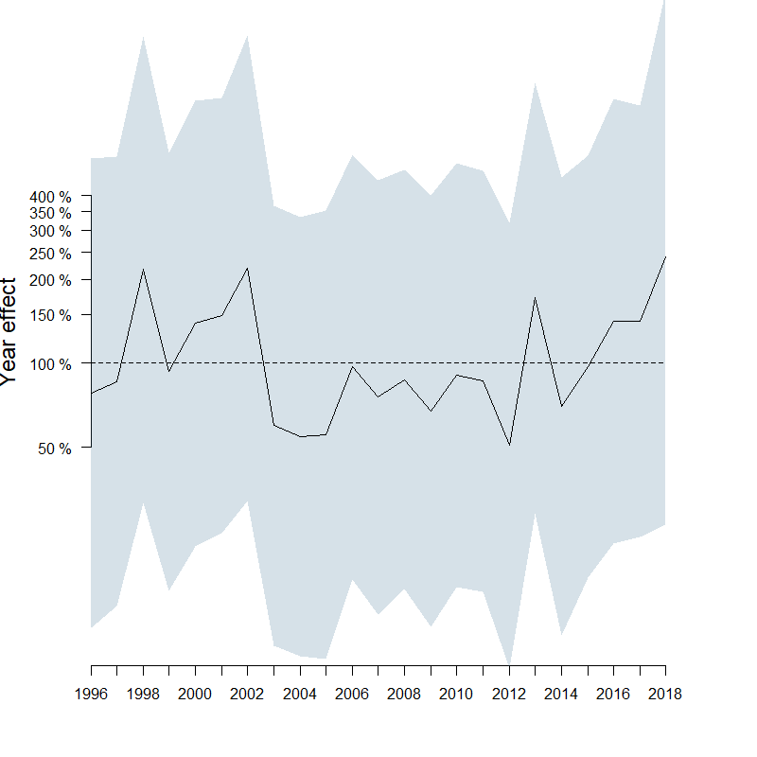
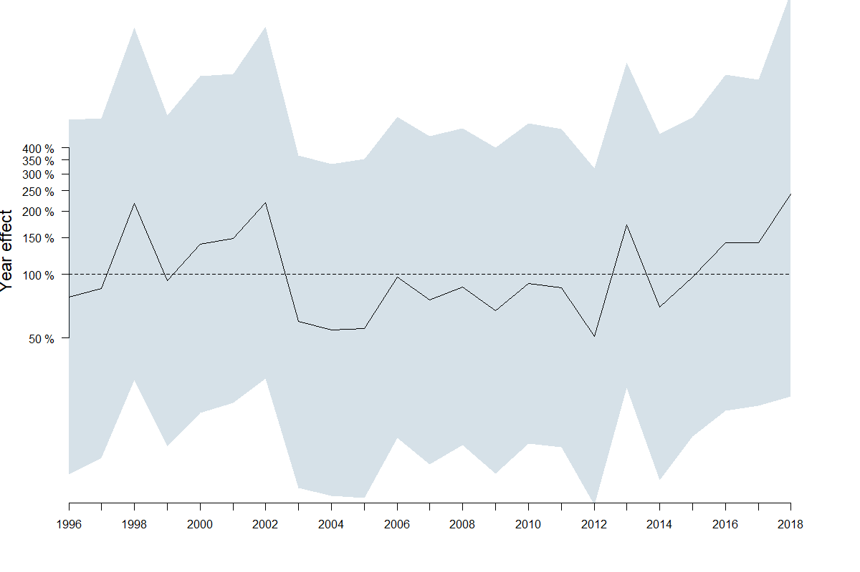

Slide 50
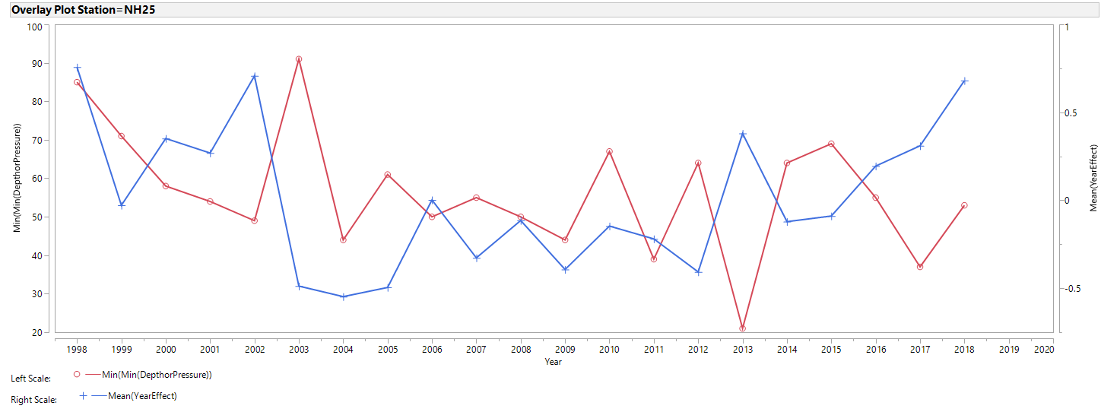
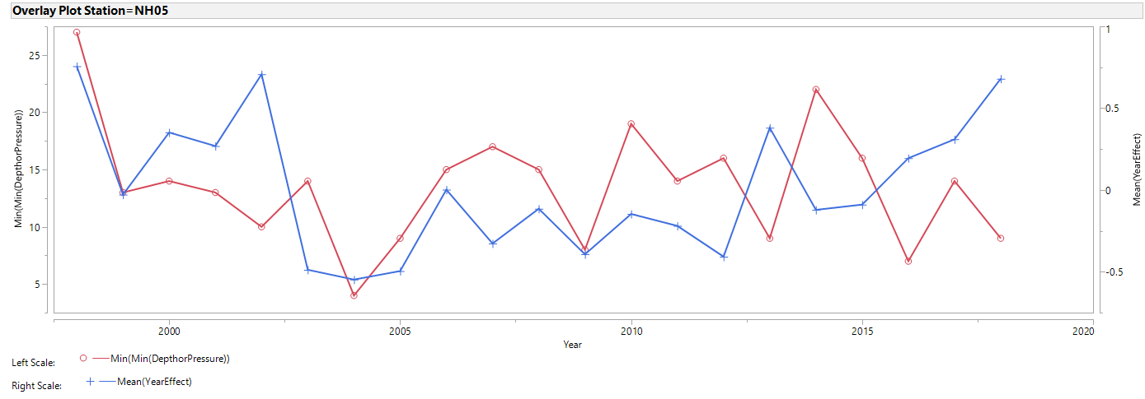

Slide 51
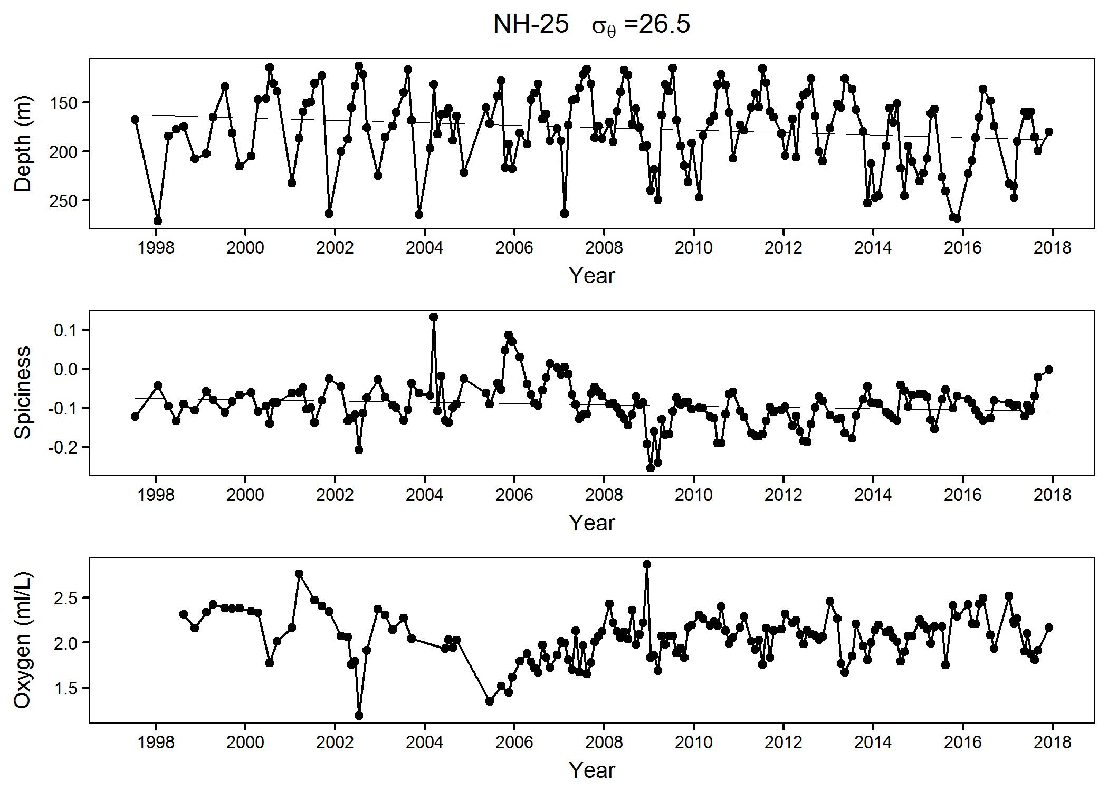

Slide 52
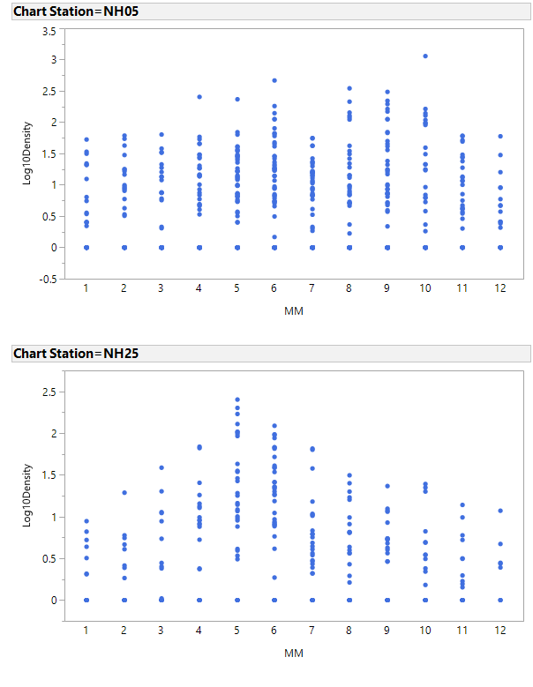

Slide 54
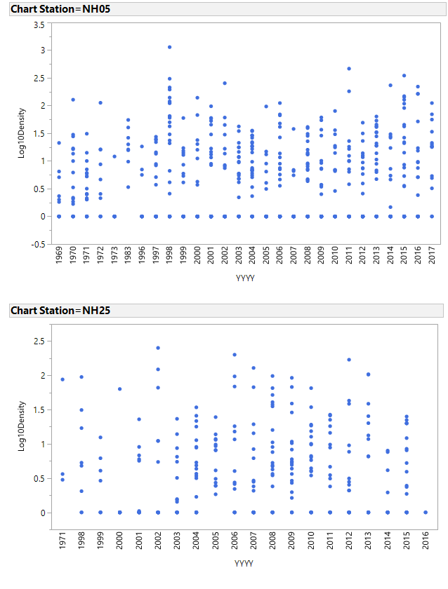

Slide 55
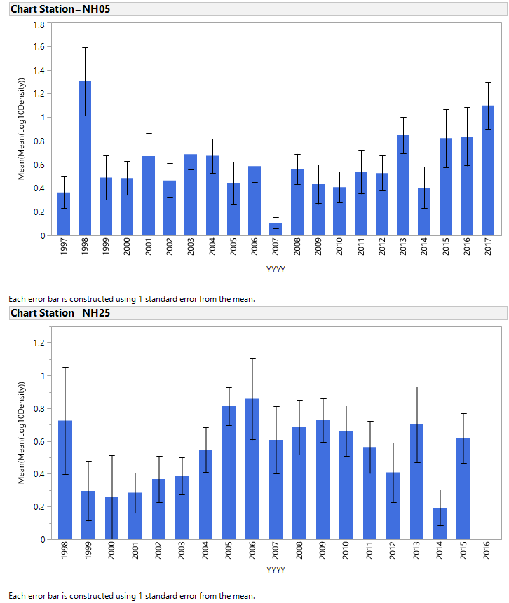

Slide 56
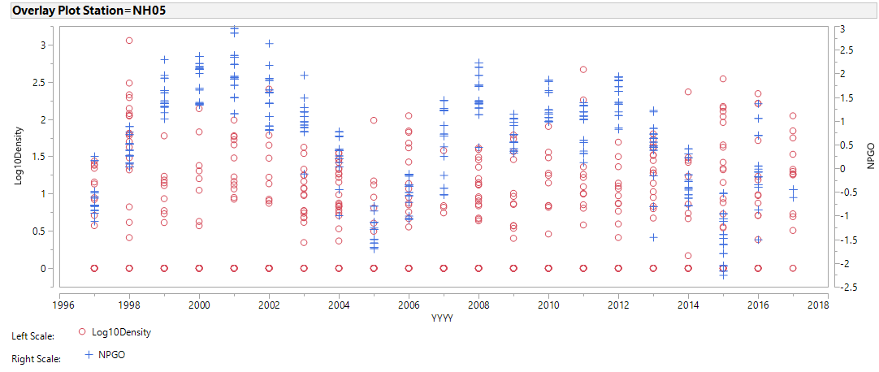
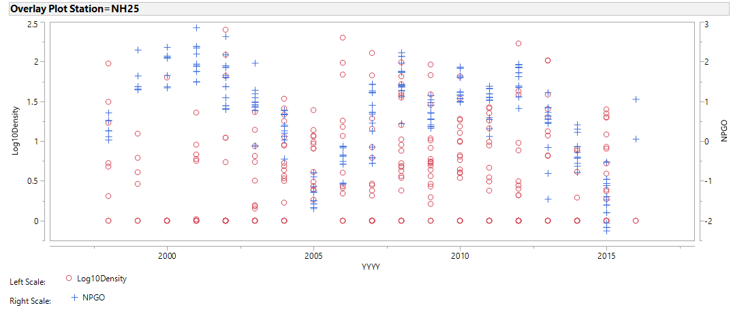

Slide 57
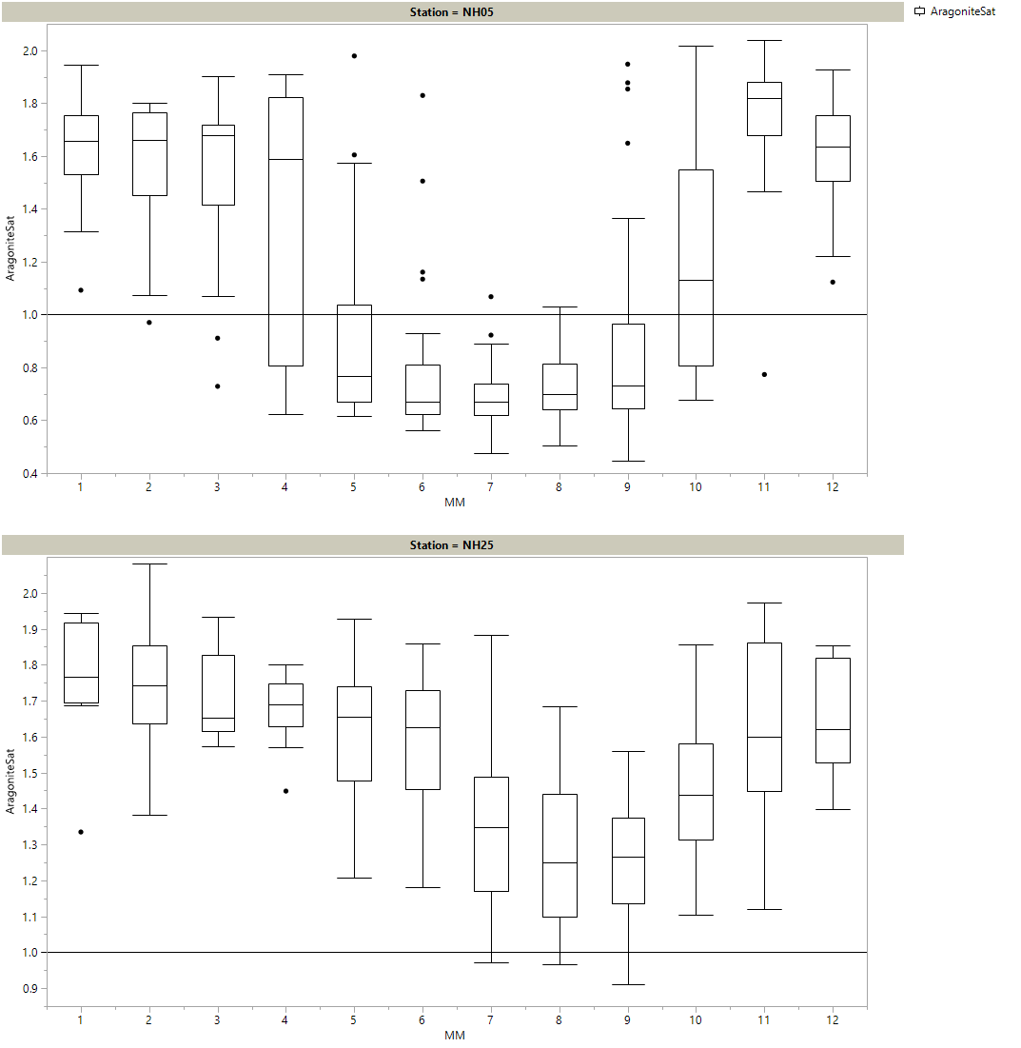

Slide 58
